Slide 1
Introductory Programming
& Problem Solving
Tutorial Week-8

Slide 2


Slide 3
Concepts we discussed
Error Handling
Exceptions
Try & Except
Validation

Slide 4
What is Exception
It is a problem that arises during the execution of a program.
When an Exception occurs the normal flow of the program is disrupted and the program/Application terminates abnormally, which is not recommended.
Therefore, these exceptions are to be handled.

Slide 5
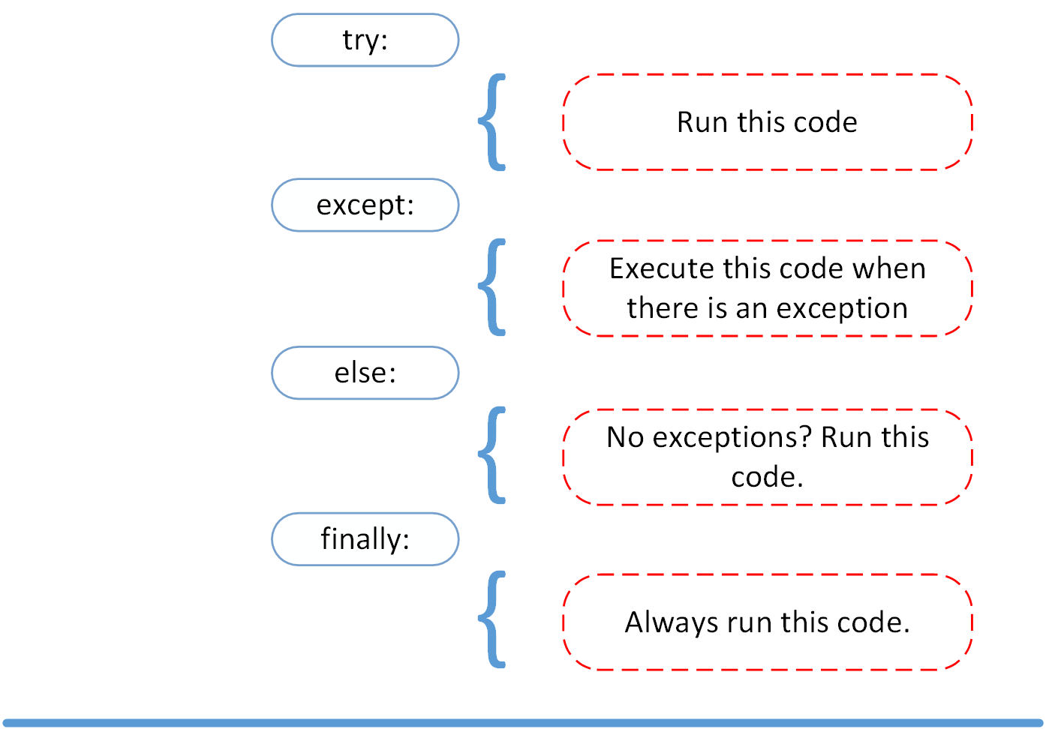
Standard Python Exception

Slide 6
Exception Handling
The try...except block is used to handle exceptions in Python.
try:
# code that may cause exception except:
# code to run when exception occurs

Slide 7
Example 1
try:
numerator = 10
denominator = 0
result = numerator/denominator print(result)
except ZeroDivisionError:
print("Error: Denominator cannot be 0.")
# Output: Error: Denominator cannot be 0.

Slide 8
Example 2
try:
num1 = int(input("Enter a number: "))
num2 = int(input("Enter another number: "))
# This will raise a ZeroDivisionError exception if num2 is zero result = num1 / num2
print("Result is:", result)
except ZeroDivisionError:
# handle the ZeroDivisionError exception print("Error: Cannot divide by zero.")
except ValueError:
# handle the ValueError exception if user input is not an integer print("Error: Please enter valid integers.")

Slide 9
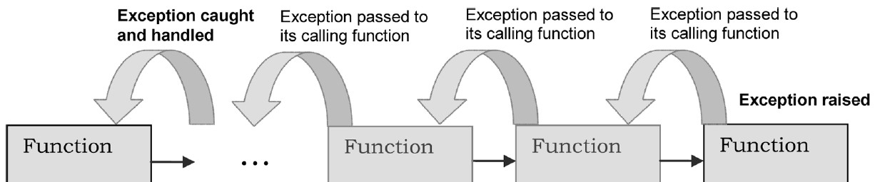
Propagation of Raised Exceptions
When an exception is raised, the program looks for an exception handler to handle it. If no handler is found, the program searches for an exception handler in the calling functions or methods.
This process is called "propagation of exceptions" and continues until the exception is handled or reaches the top-level of the program.
Multiple exceptions may be propagated simultaneously, and the handler must be able to handle all of them.
Proper exception handling is important for program stability and debugging.

Slide 10
Example
def function_c():
print("Starting function_c")
raise ValueError("An error occurred in function_c")
def function_b():
print("Starting function_b")
function_c()
print("Finished function_b")
def function_a():
print("Starting function_a")
try:
function_b()
except ValueError as e:
print(f"Caught exception: {e}")
print("Finished function_a")
#function call
function_a()
#output
Starting function_a Starting function_b Starting function_c
Caught exception: An error occurred in function_c
Finished function_a

Slide 11
Exception handling a file processing
try:
with open("example.txt", "r") as file: data = file.read()
print(data)
except FileNotFoundError: print("File not found")
except PermissionError: print("File access denied")
except Exception as e: print(f"An error occurred: {e}")

Slide 12
Catching multiple exceptions
try:
usr_input = int(input('Enter a number: ')) result = 12/ usr_input
except (FileNotFoundError, ValueError, ZeroDivisionError) as e: print(f"An error occurred: {e}")
#Exercise:
Modify the previous code to read a number from a file that you create, instead of taking user input. Write the number to the file, then read it from the file and retrieve the number using Python code.

Slide 13
Raising Exception
In python, 'raise' statement manually raise an exception
Useful to stop execution and report an error or unexpected behaviour in the code
raise Exception("Error message"):
This will raise a generic 'Exception' and pass an error message string as argument
raise Exception:
This will raise a generic 'Exception' without any error message attached

Slide 14
Raising Exception Example
def divide(x, y): if y == 0:
raise ValueError("Cannot divide by zero") return x / y
#Now try without any message, is there any difference?
try:
result = divide(10, 0) print(result)
except ValueError as e: print(e)

Slide 15
Base Exception
It is the parent class for all built-in exceptions customize how an exception is raised and handled Some common methods are as follows:
'__str__(self)': returns a string representation of the exception 'args': returns a tuple of arguments passed to the exception 'with_traceback(tb)': attaches a traceback to the exception
Can also be used to print an error message and then re-raise the exception

Slide 16
Base Exception Example
Good Practice !!
try:
f = open('myfile.txt') s = f.readline()
i = int(s.strip())
except BaseException as err: print("Error: {0}".format(err))
Very bad idea !!
try:
f = open('myfile.txt') s = f.readline()
i = int(s.strip())
except BaseException as err: pass
All exceptions inherit from BaseException, and so it can be used to serve as a wildcard. Use this with extreme caution, since it is easy to mask a real programming error in this way!

Slide 17
No Exceptions Occurred
def divide_numbers(num1, num2): try:
result = num1 / num2 except ZeroDivisionError:
print("Error: cannot divide by zero") else:
print(f"The result of dividing {num1} by {num2} is {result}")
#function call divide_numbers(10, 2)
#Output
The result of dividing 10 by 2 is 5.0
#function call divide_numbers(10, 0)
#Output
Error: cannot divide by zero

Slide 18
Exercises
Write a Python program to ask the user for 2 numbers. Then print out the result of the first number divided by the second number. Handle the 'ZeroDivisionError' exception to give a meaningful output.
Write a Python program that prompts the user to input two numbers and raises a TypeError exception if the inputs are not numerical.
Write a Python program that prompts the user to input an integer and raises a ValueError exception if the input is not a valid integer.
Find 5 previous questions and handle exception

Slide 19
Ask Me Anything!

